Slide 1
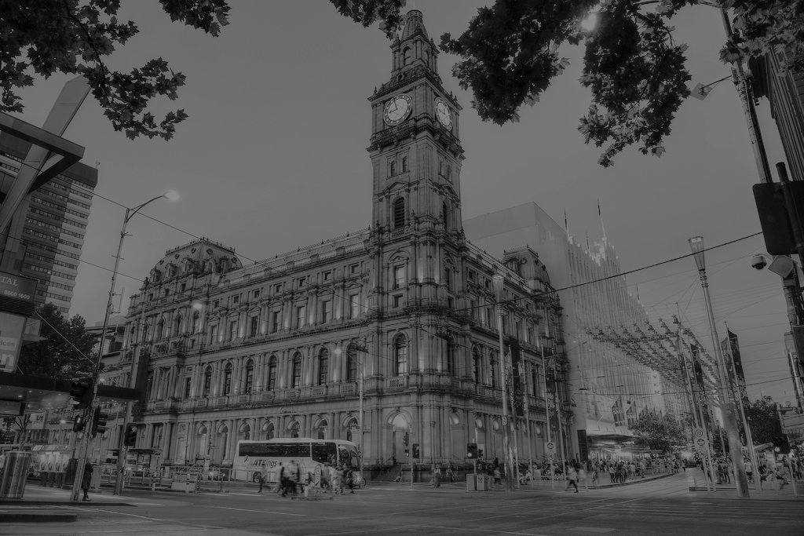
In 2016, there were 735 traffic accidents on our Melbourne roads. 135 pedestrians were involved.
Notes:
In 2016 there were 735 traffic related accidents with 136 pedestrians involed.

Slide 2
Managing Melbourne’s Traffic
Team-danger zone
Stephen McCalma
Raj Vijayaraghavan
Ignacio Recasens
A decision-making tool for future growth
Notes:
Hi,
We are team-danger zone and we are paticipating for the challenge of Melbourne Planning growth.
My name is Ignacio and I Will present a beta versión of a decision-making tool we have built with Stephen and Raj.

Slide 3

Challenge:
develop innovative new ideas where data can be used to help plan for a growing city.
https://2017.hackerspace.govhack.org/award/grow-melbourne-city-planning-growth
Notes:
One of the main challenges for city councils is to plan for the growth of the city considering many factors such as pedestrian density traffic congestion, and accidents aorund the city.

Slide 4

Task: design a tool for city managers that helps to plan and respond to city growth in Melbourne
Notes:
With so many datasets it can be difficult to work with them efficiently and fast on a daily basis.
We decided to build a tool that can ease this type of work.

Slide 5
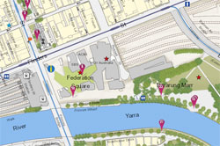
Problem:
Where are potential danger zones of high pedestrian counts combined with high traffic volumes?
Notes:
It’s important to visualize the information and what better way than to do it directly from a map.
It makes it easier to find hot spots that may induce accidents or congestion.

Slide 6
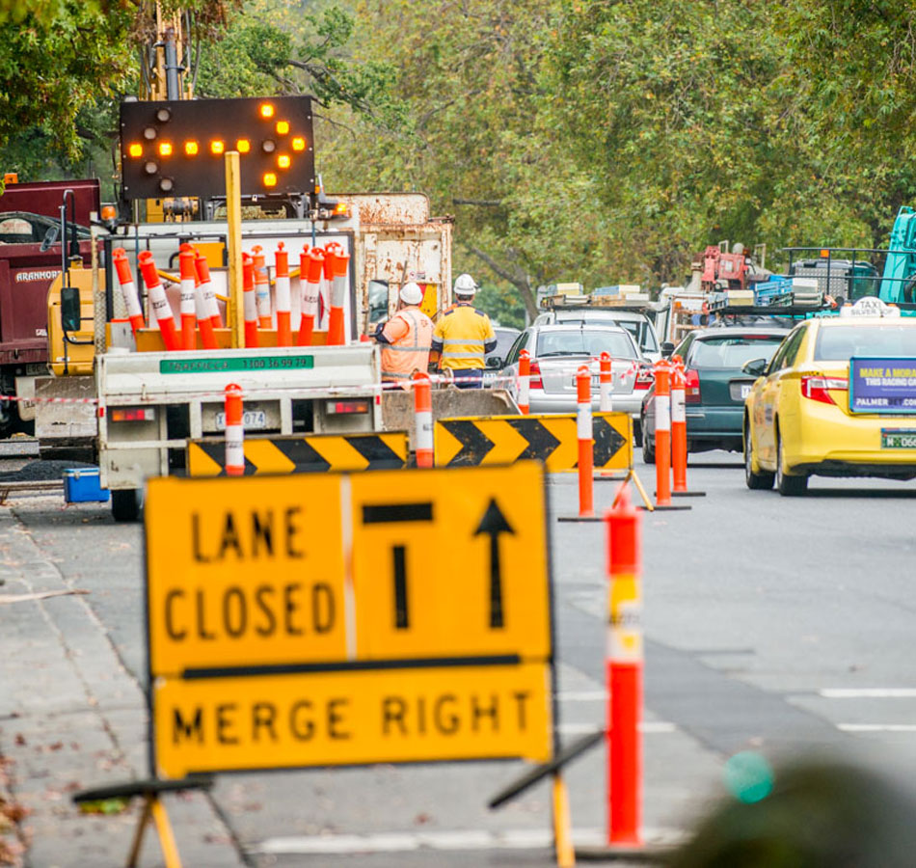
Approach:
Mashup pedestrian information with traffic, new developments and accidents data to create visualisations and analytics.
Notes:
We decided to créate a tool that joins data from accidents, traffic congestion, pedestrians density and new developments so that managers can respond quickly to demands for city growth.

Slide 7
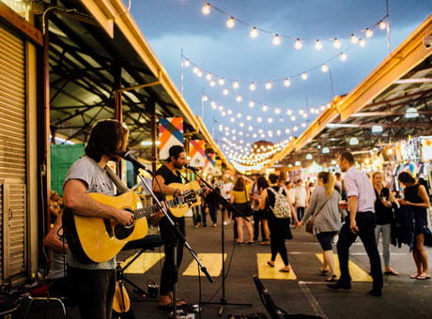
Goal:
Reduce deaths or injuries due to pedestrian-related traffic incidents through more-informed planning.
Notes:
One of the main goals is to reduce accidents due to pedestrian related traffic incidents through more a informed Planning.

Slide 8
Datasets:
Pedestrian traffic count
City of Melbourne
Traffic Count Vehicle
City of Melbourne
Crash Statistics data
VicRoads
Notes:
The data sets used were.
Pedestrian and vehicle traffic from city of Melbourne data
And crash statistics from VicRoads data.

Slide 9
Tableau Demo

Slide 10
Key Outputs
Github Repo
Video
Notebooks
Other files
https://github.com/irecasens/govhack_team
Data Sources: https://data.melbourne.vic.gov.au/Transport-Movement/Pedestrian-traffic-hourly-count/cb85-mn2u
https://data.melbourne.vic.gov.au/Transport-Movement/Traffic-Count-Vehicle-Classification-2014-2017/qksr-hqee
https://www.data.vic.gov.au/data/dataset/crash-stats-data-extract
Notes:
Thank you for listening

